Slide 1
GET YOUR
POKER FACE ON:
HOW TO USE PLANNING POKER TO SLAY PROJECT ESTIMATIONS
LAURA B. JANUSEK
CHIEF PRODUCT OFFICER
MODERN TEACHER
@LBJANUSEK
#OSCON

Slide 2
WHAT ARE WE DOING HERE?
PLANNING POKER:
What & Why
GET
REAL:
Examples from MT
LIVE ESTIMATIONS:
Planning Poker in Action!
NEXT
STEPS:
Roadmapping our Road Trip
BE
SAASY:
Review of Online Tools
THAT’S A WRAP:
Q&A Time

Slide 3
WHAT ARE WE DOING HERE?
PLANNING POKER:
What & Why
GET
REAL:
Examples from MT
LIVE ESTIMATIONS:
Planning Poker in Action!
NEXT
STEPS:
Roadmapping our Road Trip
BE
SAASY:
Review of Online Tools
THAT’S A WRAP:
Q&A Time

Slide 4
#NoEstimates
Estimates can be too low
Lots of techniques exist to improve accuracy
Estimates can be too high
There are worse things
Estimates can be misused by management
Management needs training
Estimates cut into dev time
Not very much
Estimates are unnecessary – we should build whatever has the most value and then move on to the next
Define value

Slide 5
Planning Poker is a consensus-based estimation technique used by Agile teams globally.

Slide 6
HISTORY
1948 – RAND Corporation formed, think tank that advises U.S. Armed Forces, later creates Delphi Method

Slide 7
HISTORY
1948 – RAND Corporation formed, think tank that advises U.S. Armed Forces, later creates Delphi Method
1970s – Barry Boehm proposes “Wideband Delphi” method, popularized in Software Engineering Economics (1981)

Slide 8
HISTORY
1948 – RAND Corporation formed, think tank that advises U.S. Armed Forces, later creates Delphi Method
1970s – Barry Boehm proposes “Wideband Delphi” method, popularized in Software Engineering Economics (1981)
2002 – Current form set out in article by James Grenning

Slide 9
HISTORY
1948 – RAND Corporation formed, think tank that advises U.S. Armed Forces, later creates Delphi Method
1970s – Barry Boehm proposes “Wideband Delphi” method, popularized in Software Engineering Economics (1981)
2002 – Current form set out in article by James Grenning
2005 – Popularized by Mike Cohn’s “Agile Estimating and Planning”, trademarked by Mountain Goat Software

Slide 10
HISTORY
1948 – RAND Corporation formed, think tank that advises U.S. Armed Forces, later creates Delphi Method
1970s – Barry Boehm proposes “Wideband Delphi” method, popularized in Software Engineering Economics (1981)
2002 – Current form set out in article by James Grenning
2005 – Popularized by Mike Cohn’s “Agile Estimating and Planning”, trademarked by Mountain Goat Software
Today – Variations used worldwide with a range of techniques & tools

Slide 11
HOW IT WORKS

Slide 12
HOW IT WORKS

Slide 13
HOW IT WORKS

Slide 14
HOW IT WORKS

Slide 15
HOW IT WORKS

Slide 16
HOW IT WORKS

Slide 17
HOW IT WORKS

Slide 18
HOW IT WORKS

Slide 19
HOW IT WORKS

Slide 20
HOW IT WORKS

Slide 21
DISAGREEMENTS
HOW TO GET THE FINAL ESTIMATE
Keep voting until everyone votes the same number
Keep voting until estimates are “close enough” and average them
Average the votes even if they’re not very close
When averaging, keep exact average or round up

Slide 22
DISAGREEMENTS
HOW TO GET THE FINAL ESTIMATE
NUMBER SEQUENCING
Playing Cards:
Ace, 2, 3, 4, 5, 6… King
Modified Fibonacci:
0, ½, 1, 3, 5, 8, 13, 20, 40, 100
Sequential:
0, ½, 1, 2, 3, 4, 5, 6, 7, 8, 9, 10, 15…
T-Shirt Sizes:
xxs, xs, s, m, l, xl, xxl
With Icons:
Infinity means it can’t be done, coffee cup means I need a break
And what do the numbers mean? Story points, ideal days, etc.

Slide 23
DISAGREEMENTS
HOW TO GET THE FINAL ESTIMATE
NUMBER SEQUENCING
TO TIME OR NOT TO TIME
Original purpose was to keep estimation meetings moving (Agile Alliance)
Use a timer to limit each round?
Use a timer to limit vote justifications?
How long to set in both cases?

Slide 24
DISAGREEMENTS
HOW TO GET THE FINAL ESTIMATE
NUMBER SEQUENCING
TO TIME OR NOT TO TIME
?

Slide 25
BENEFITS
Promotes accuracy, prevents bias
Keeps things organized & moving
Can assist in task assignment
Allows for multiple timelines based on cuts

Slide 26
WHAT ARE WE DOING HERE?
PLANNING POKER:
What & Why
GET
REAL:
Examples from MT
LIVE ESTIMATIONS:
Planning Poker in Action!
NEXT
STEPS:
Roadmapping our Road Trip
BE
SAASY:
Review of Online Tools
THAT’S A WRAP:
Q&A Time

Slide 27
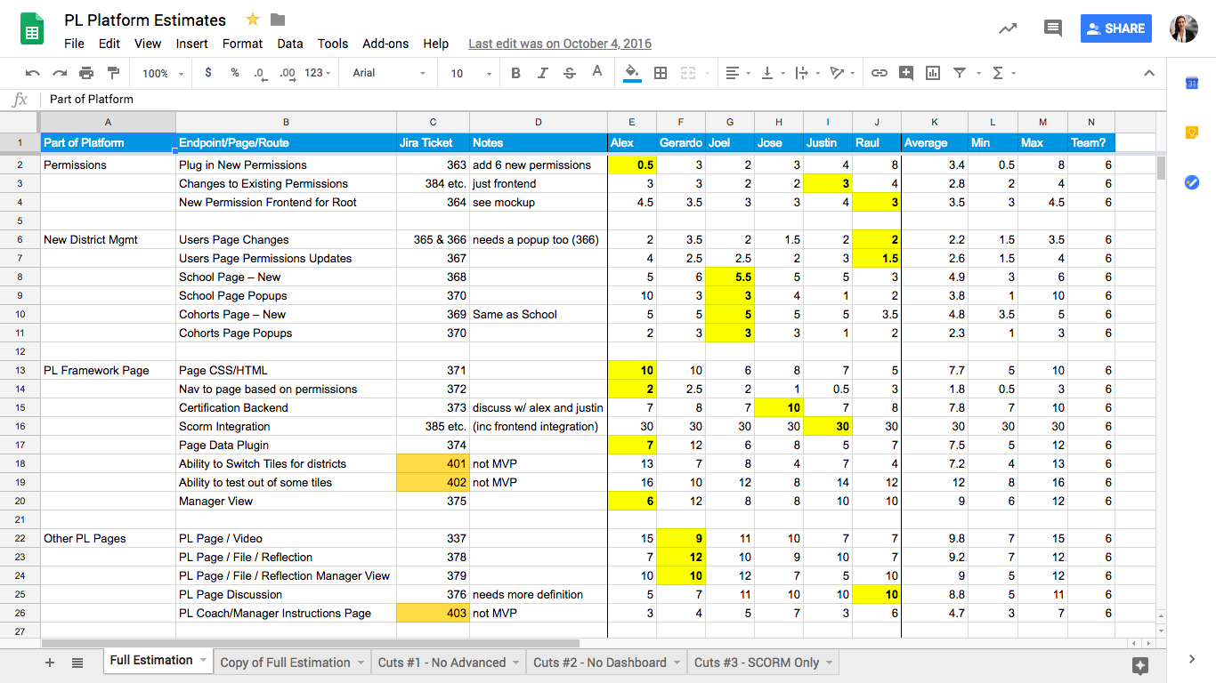

Slide 28
196
RAW MATH
6 Devs
5 days/week
30 points/week
196/30 = 6.4 weeks!

Slide 29
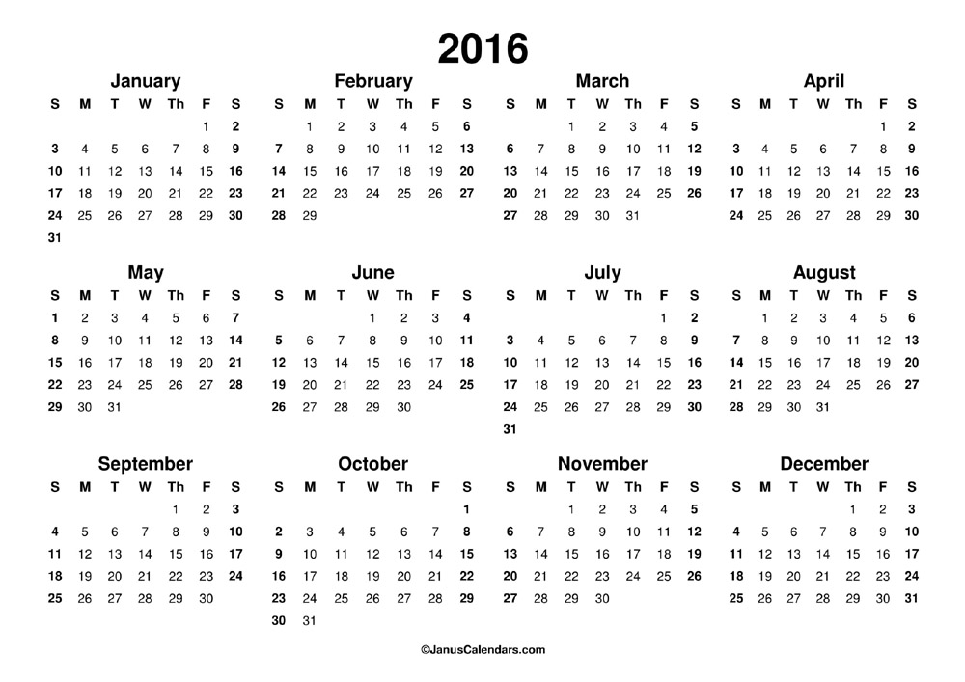

Slide 30
196
RAW MATH = 6.4 weeks
VELOCITY
20 points/week
196/20 = 9.8 weeks!

Slide 32
196
RAW MATH = 6.4 weeks
VELOCITY = 9.8 weeks
MAINTENANCE
3 points/week
Velocity = 17/week
196/17= 11.5 weeks!

Slide 34
196
RAW MATH = 6.4 weeks
VELOCITY = 9.8 weeks
MAINTENANCE = 11.5 weeks
UNKNOWNS
35% increase!
196 * .35 = 67.55
196 + 67.55 = 263.55
263.55/17 = 15.5 weeks!

Slide 36
196
RAW MATH = 6.4 weeks
VELOCITY = 9.8 weeks
MAINTENANCE = 11.5 weeks
UNKNOWNS = 15.5 weeks
DAYS OFF
Thanksgiving = 1 week
Vacations/Sick = 1 week
Total = 17.5 weeks

Slide 38
196
RAW MATH = 6.4 weeks
VELOCITY = 9.8 weeks
MAINTENANCE = 11.5 weeks
UNKNOWNS = 15.5 weeks
DAYS OFF = 17.5 weeks
QUALITY ASSURANCE
Regression Testing & Cleanup = 1 week
Total = 18.5 weeks!

Slide 40
PLAN FOR
HISTORICAL VELOCITY
MAINTENANCE
UNKNOWNS
DAYS OFF
QUALITY ASSURACE

Slide 42
WHAT ARE WE DOING HERE?
PLANNING POKER:
What & Why
GET
REAL:
Examples from MT
LIVE ESTIMATIONS:
Planning Poker in Action!
NEXT
STEPS:
Roadmapping our Road Trip
BE
SAASY:
Review of Online Tools
THAT’S A WRAP:
Q&A Time

Slide 43
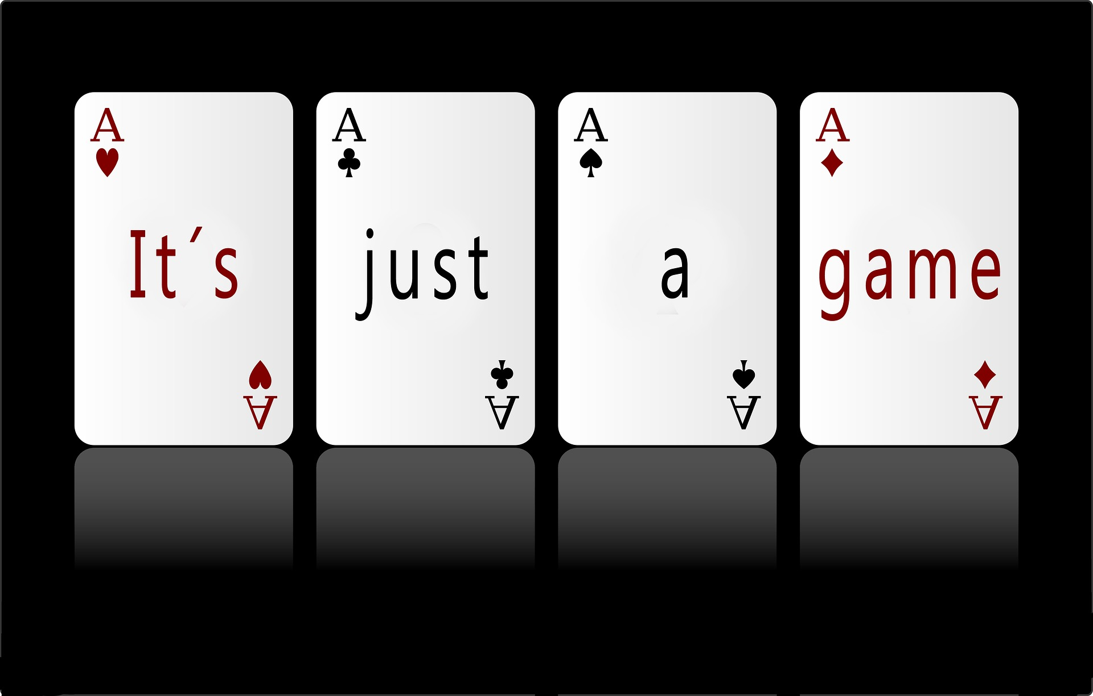

Slide 44
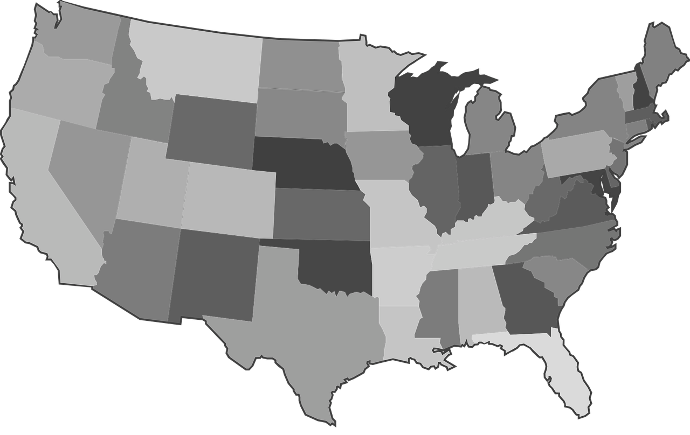
Notes:
Baltimore to Philadelphia – 2 hours

Slide 45
Notes:
Indianapolis to Nashville – 5 hours

Slide 46
Notes:
Green Bay WI to Traverse City MI
If drive around bottom – 8.5 hr
If drive around top – 6.5 hr
If take northern ferry – 6hr 15min

Slide 47
bit.ly/osconpoker1

Slide 48
Notes:
Chicago to St Louis – 4h 41

Slide 49
Notes:
St Louis to Denver – 12h 14m

Slide 50
Notes:
Denver to El Paso – 9h 44m

Slide 52
Notes:
El Paso to Vegas – 10h 44m
Vegas to LA – 4h 9m

Slide 54
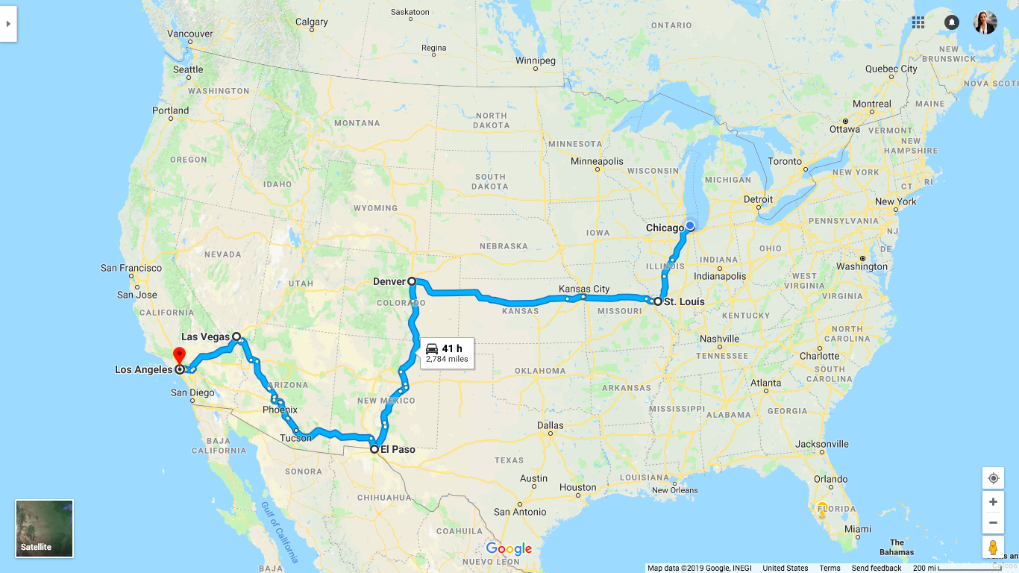

Slide 55
WHAT ARE WE DOING HERE?
PLANNING POKER:
What & Why
GET
REAL:
Examples from MT
LIVE ESTIMATIONS:
Planning Poker in Action!
NEXT
STEPS:
Roadmapping our Road Trip
BE
SAASY:
Review of Online Tools
THAT’S A WRAP:
Q&A Time

Slide 56
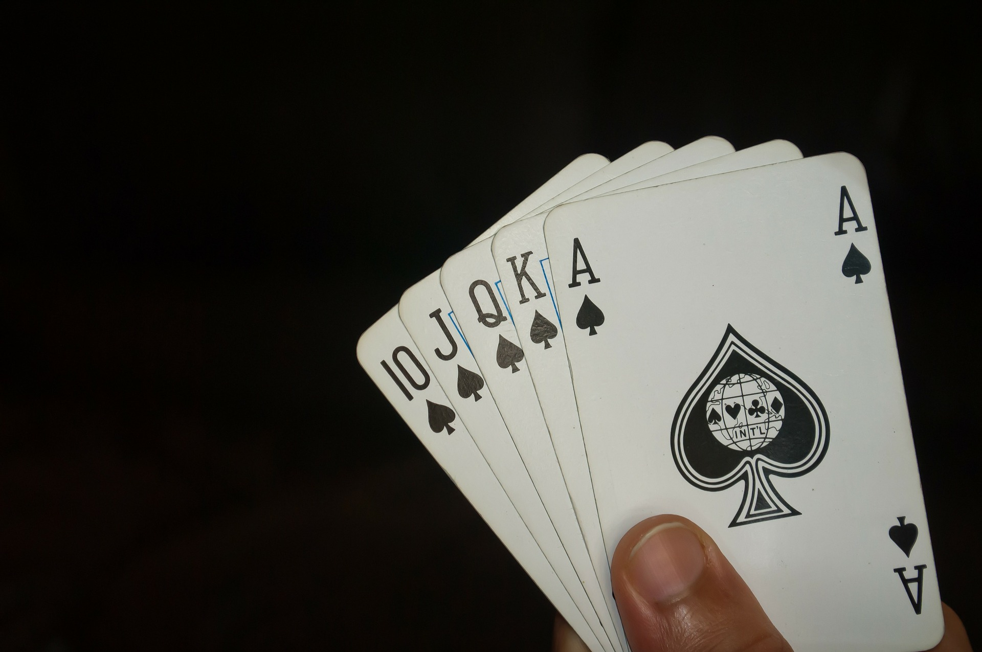
41 Hours
RAW MATH
24 hours in a day
41/24 = 1.7 days!

Slide 57
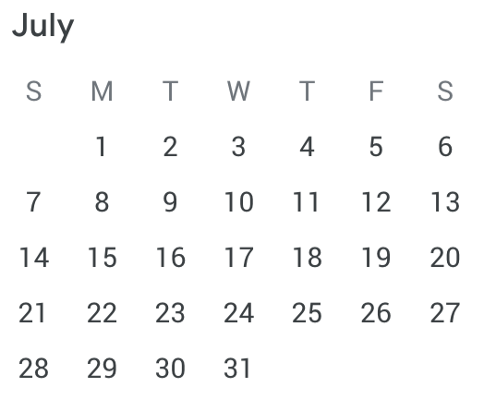

Slide 58
41 Hours
RAW MATH = 1.7 days
VELOCITY
6 hours/day
41/6 = 6.8 days

Slide 60
41 Hours
RAW MATH = 1.7 days
VELOCITY = 6.8 days
MAINTENANCE
Getting gas, bathroom breaks, etc. = 1 hour/day
41/5 = 8.2 days

Slide 62
41 Hours
RAW MATH = 1.7 days
VELOCITY = 6.8 days
MAINTENANCE = 8.2 days
UNKNOWNS
Known Unknowns: Construction on the route
Unknown Unknowns: Flat tire, fender bender, etc.
Scope Creep: While we’re in the area…
30% increase!
41* .3 = 12.3
41+ 12.3 = 53.3
53.3/5 = 10.7 days!

Slide 64
41 Hours
RAW MATH = 1.7 days
VELOCITY = 6.8 days
MAINTENANCE = 8.2 days
UNKNOWNS = 10.7 days
DAYS OFF
4th of July = push back start by 1 week!

Slide 66
41 Hours
RAW MATH = 1.7 days
VELOCITY = 6.8 days
MAINTENANCE = 8.2 days
UNKNOWNS = 10.7 days
DAYS OFF = 17.7 days
QUALITY ASSURANCE
Must spend 1 day in each city on the route
6 cities = 6 days
Total = 23.7 days!

Slide 68
PLAN FOR
HISTORICAL VELOCITY
MAINTENANCE
UNKNOWNS
DAYS OFF
QUALITY ASSURACE

Slide 69
WHAT ARE WE DOING HERE?
PLANNING POKER:
What & Why
GET
REAL:
Examples from MT
LIVE ESTIMATIONS:
Planning Poker in Action!
NEXT
STEPS:
Roadmapping our Road Trip
BE
SAASY:
Review of Online Tools
THAT’S A WRAP:
Q&A Time

Slide 70
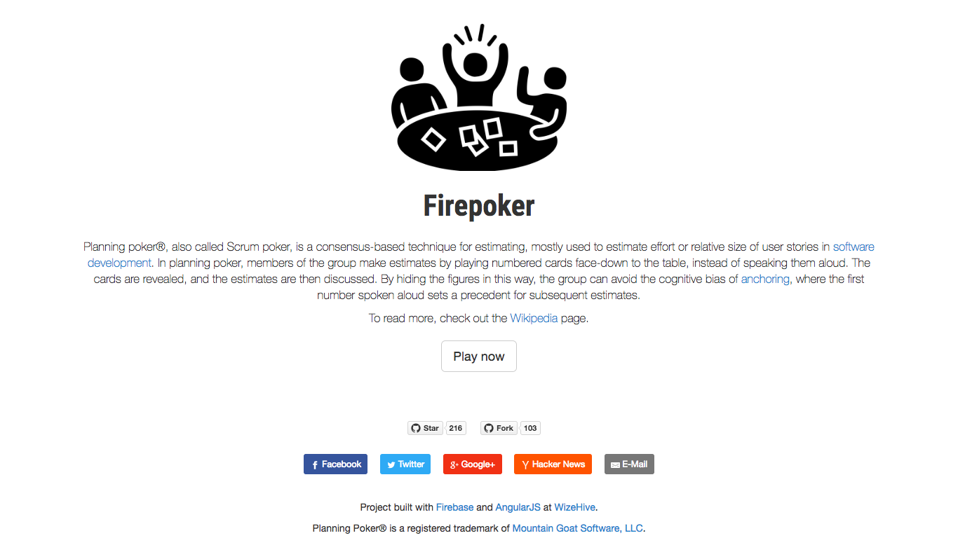
HISTORY OF FINAL ESTIMATE
HISTORY OF INDIVIDUAL ESTIMATES
CUSTOM NUMBER SEQUENCE
CSV EXPORT
INTEGRATIONS
Notes:
Very simple. No login or way to save
Can select from a few options for numbering
Can do multiple stories and see history of final estimates, but not of individual ones

Slide 71
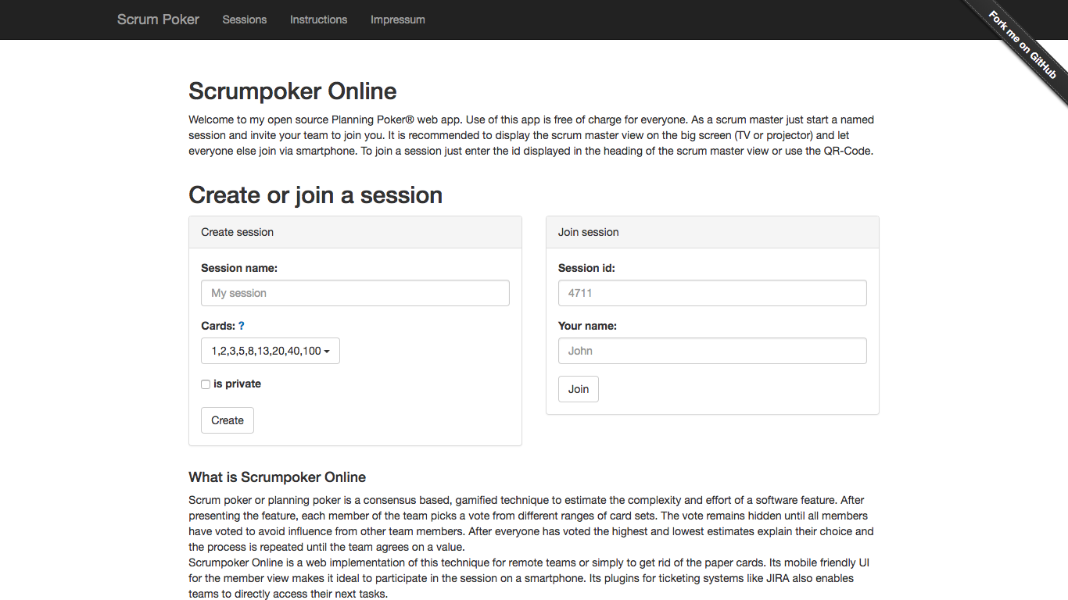
HISTORY OF FINAL ESTIMATE
HISTORY OF INDIVIDUAL ESTIMATES
CUSTOM NUMBER SEQUENCE
CSV EXPORT
INTEGRATIONS
Notes:
Has some options for number sequences but can’t set own
Doesn’t create an average
No history of stories, just one at a time

Slide 72
HISTORY OF FINAL ESTIMATE
HISTORY OF INDIVIDUAL ESTIMATES
CUSTOM NUMBER SEQUENCE
CSV EXPORT
INTEGRATIONS
Notes:
Nice UI with history of all estimates
CSV export, but only shows average, not estimate of each player
Can create own number sequence
Can edit final estimate number instead of their auto round-up average

Slide 73
HISTORY OF FINAL ESTIMATE
HISTORY OF INDIVIDUAL ESTIMATES
CUSTOM NUMBER SEQUENCE
CSV EXPORT
INTEGRATIONS
Notes:
Can select from numbering options or create own
Can have multiple rooms with saved history
On card “flip”, gives bar graph of which estimates were most popular
Saves final estimate but not individuals
No CSV export, but website says has Jira integration

Slide 74
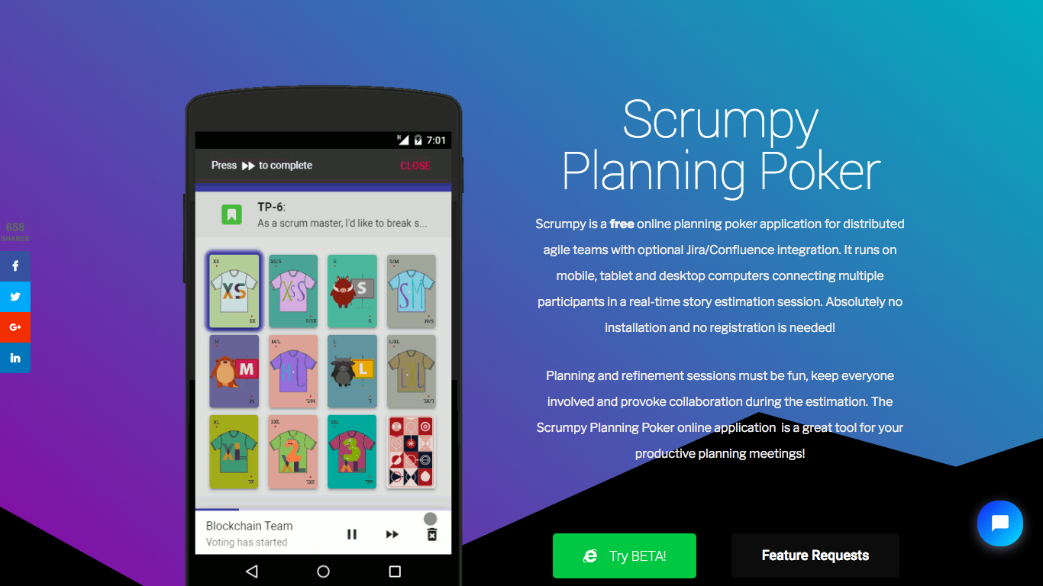
HISTORY OF FINAL ESTIMATE
HISTORY OF INDIVIDUAL ESTIMATES
CUSTOM NUMBER SEQUENCE
CSV EXPORT
INTEGRATIONS
Notes:
New, just in beta. No login or way to save?
Emphasizes integrations (Jira, Slack, Stride) but no CSV export. Also can be used as Jira plugin
Gives numbering options or can allow open votes of any number
Can see individual votes, but can’t see who voted them. Loses card flip feeling

Slide 75
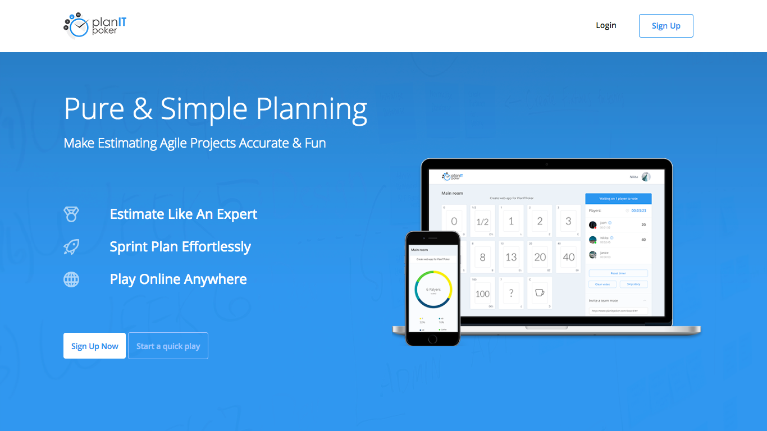
HISTORY OF FINAL ESTIMATE
HISTORY OF INDIVIDUAL ESTIMATES
CUSTOM NUMBER SEQUENCE
CSV EXPORT
INTEGRATIONS
Notes:
Gives sequencing options but doesn’t let you set your own
Does CSV export of final estimates
More advanced features, like timer and hiding realtime votes, but I couldn’t get them to work

Slide 76
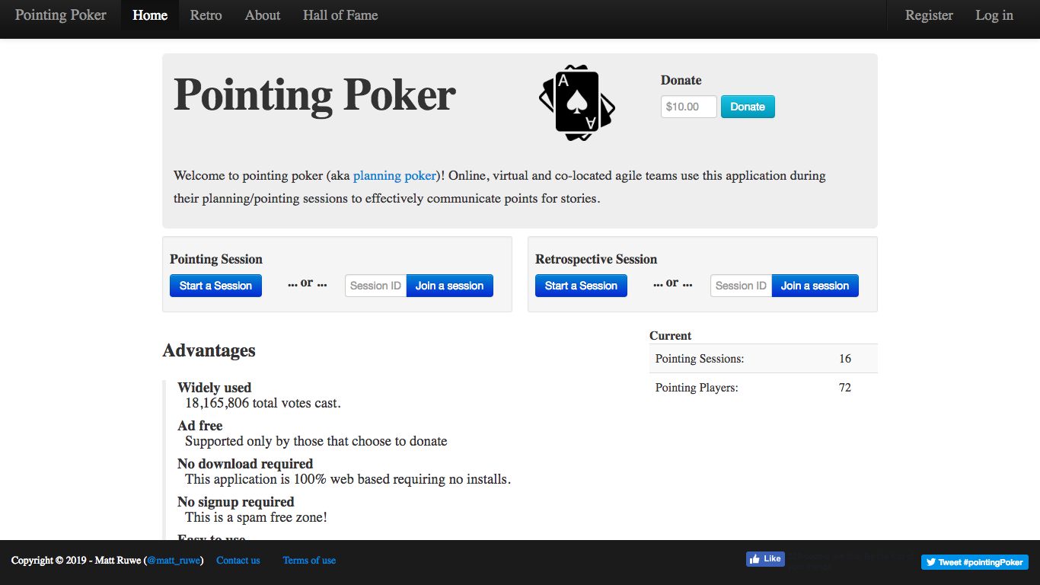
HISTORY OF FINAL ESTIMATE
HISTORY OF INDIVIDUAL ESTIMATES
CUSTOM NUMBER SEQUENCE
CSV EXPORT
INTEGRATIONS
Notes:
Lets you set points values
Does save history of individual estimates on each story
No way to export

Slide 77
WHAT ARE WE DOING HERE?
PLANNING POKER:
What & Why
GET
REAL:
Examples from MT
LIVE ESTIMATIONS:
Planning Poker in Action!
NEXT
STEPS:
Roadmapping our Road Trip
BE
SAASY:
Review of Online Tools
THAT’S A WRAP:
Q&A Time

Slide 78
THANK YOU!
GET YOUR POKER FACE ON:
HOW TO USE PLANNING POKER TO SLAY PROJECT ESTIMATIONS
LAURA B. JANUSEK
CHIEF PRODUCT OFFICER
MODERN TEACHER
@LBJANUSEK
#OSCON

Slide 79
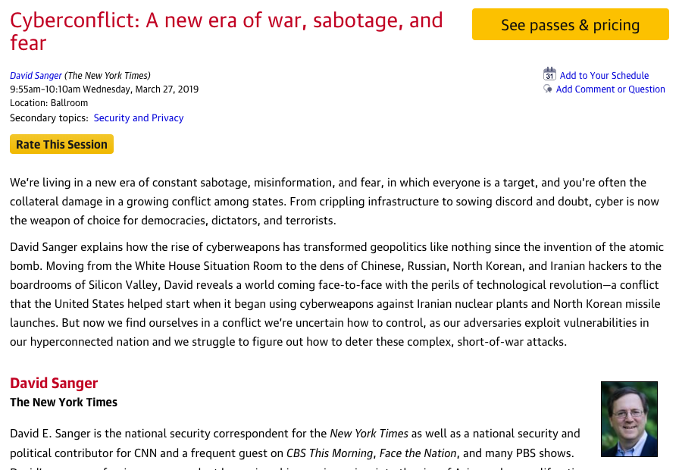
THANK YOU!
GET YOUR POKER FACE ON:
HOW TO USE PLANNING POKER TO SLAY PROJECT ESTIMATIONS
Session page on conference website
LAURA B. JANUSEK
CHIEF PRODUCT OFFICER
MODERN TEACHER
@LBJANUSEK
#OSCON
O’Reilly Events App

